Slide 1
MRA Project Milestone 1
Presented By: Tejas Padekar
Batch: PGP DSBA – G1
Email: tnpadekar@gmail.com

Slide 2
AGENDA:
About data (Continuous and Categorical)
EDA
Univariate, Bivariate and Multivariate Analysis
Inferences
RFM Analysis
Top Customers across different segments

Slide 3
PROBLEM STATEMENT:
An automobile parts manufacturing company has collected data of transactions for 3 years. They do not have any in-house data science team, thus they have hired you as their consultant. Your job is to use your magical data science skills to provide them with suitable insights about their data and their customers.
Below is the data description:
ORDERNUMBER : | Order Number | CUSTOMERNAME : | customer
QUANTITYORDERED : | Quantity ordered | PHONE : | Phone of the customer
PRICEEACH : | Price of Each item | ADDRESSLINE1 : | Address of customer
ORDERLINENUMBER : | order line | CITY : | City of customer
SALES : | Sales amount | POSTALCODE : | Postal Code of customer
ORDERDATE : | Order Date | COUNTRY : | Country customer
DAYS_SINCE_LASTORDER : | Days_ Since_Lastorder | CONTACTLASTNAME : | Contact person customer
STATUS : | Status of order like Shipped or not | CONTACTFIRSTNAME : | Contact person customer
PRODUCTLINE : | Product line – CATEGORY | DEALSIZE : | Size of the deal based on Quantity and Item Price
MSRP : | Manufacturer's Suggested Retail Price | PRODUCTCODE : | Code of Product

Slide 4
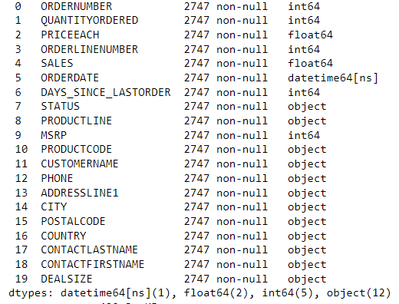
ABOUT DATA
There are 2747 rows and 20 columns.
There are 1 datetime, 2 float, 5 Integer and 12 object data types.
There are no null values in the dataset.
There are no duplicate rows in the dataset.

Slide 5
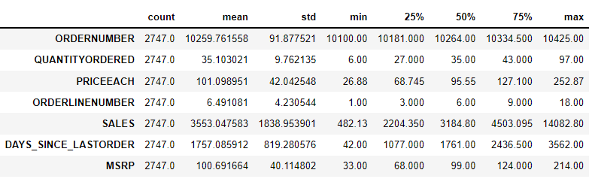
ABOUT DATA (CONTINUOUS VARIABLES)
Average of quantity ordered is 35 with min 6 and max 97.
Average for price each is 101 with min 26 and max 252
Average for Sales is 3553 with min 482 and max 14082.
There seems to be a few outliers present in the dataset.

Slide 6
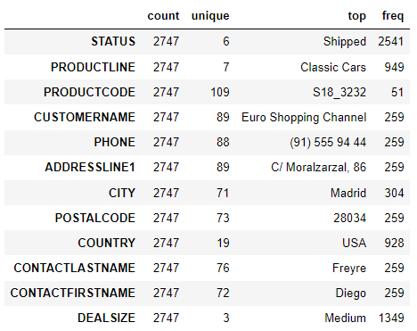
ABOUT DATA (CATEGORICAL VARIABLES)
There are 6 unique Sales Statuses.
There are 7 different product lines with 109 product codes.
There are total of 89 customers across 19 countries.
Sale Size is divided into 3 deal size categories.

Slide 7
EXPLORATARY DATA ANALYSIS
We have used Python and Tableau for performing EDA

Slide 8
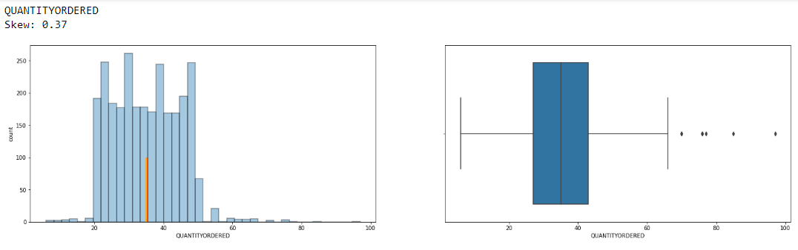
UNIVARIATE ANALYSIS DATA DISTRIBUTION & OUTLIERS
There are outliers and high skewness in QUANTITYORDERED.

Slide 9
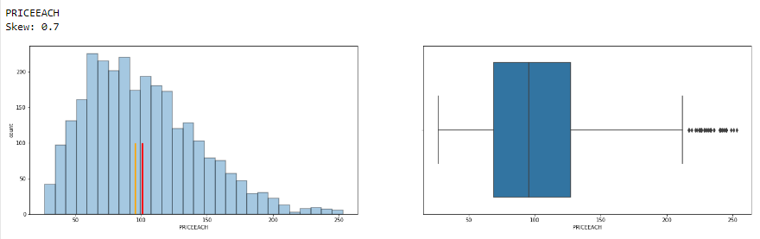
UNIVARIATE ANALYSIS DATA DISTRIBUTION & OUTLIERS
There are outliers and high skewness in PRICEEACH.

Slide 10
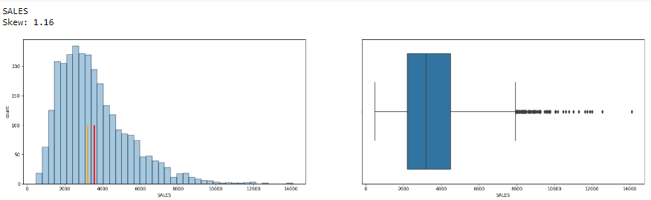
UNIVARIATE ANALYSIS DATA DISTRIBUTION & OUTLIERS
There are outliers and high skewness in SALES.

Slide 11
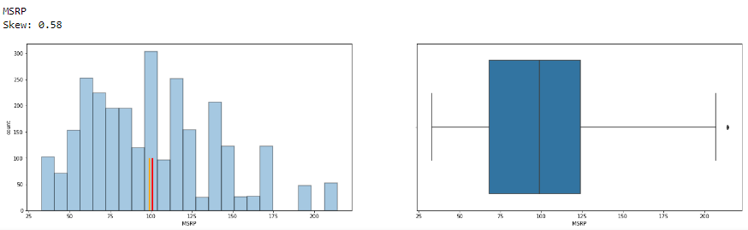
UNIVARIATE ANALYSIS DATA DISTRIBUTION & OUTLIERS
There are outliers and high skewness in MSRP.

Slide 12
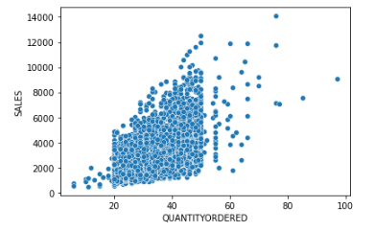
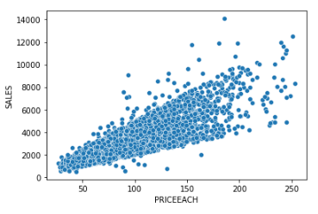
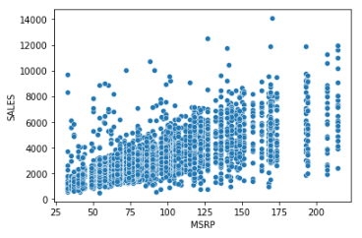
BIVARIATE ANALYSIS
We can observe below that SALES has high correlation with QUANTITYORDERED, PRICEEACH and MSRP as well.

Slide 13
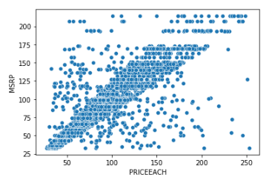
BIVARIATE ANALYSIS
We can observe below that MSRP has high correlation with PRICEEACH.

Slide 14
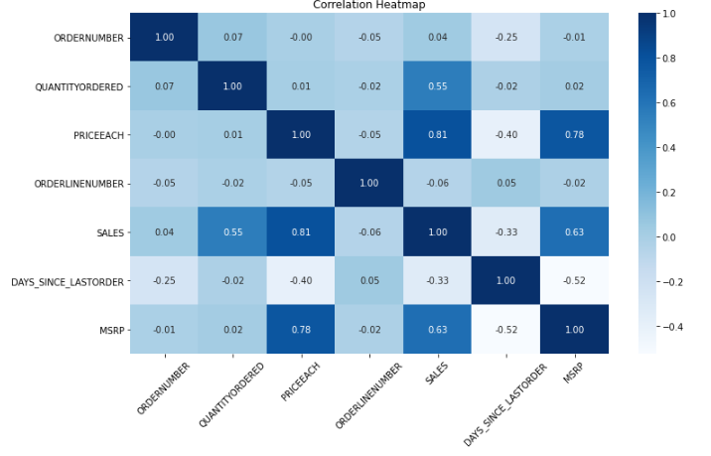
MULTIVARIATE ANALYSIS
As stated earlier, we can observe strong correlation between SALES and QUANTITYORDERED, PRICEEACH and MSRP
PRICEEACH and MSRP also have a high correlation
There is nearly no correlation between QUANTITYORDERED and PRICEEACH.

Slide 15
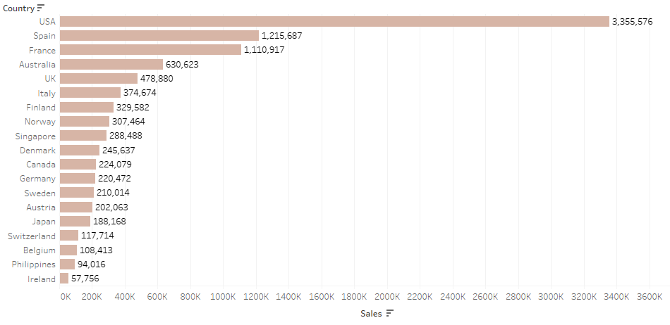
TOTAL SALES ACROSS ALL COUNTRIES
USA accounts for highest sales followed by Spain in 2nd and France in the 3rd position.
The Sales gap between USA and Spain is drastic with sales from USA nearly touching 3 times that of Spain.
Ireland has the least sales followed by Philippines and Belgium.

Slide 16
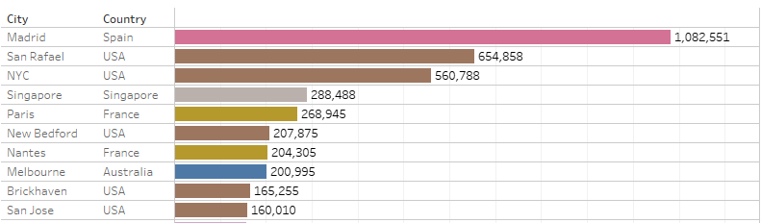
TOTAL SALES ACROSS CITIES
Madrid leads the cities with the highest sales followed by San Rafael and NYC
5 out of the top 10 cities belong to USA which contribute to maximum sales.

Slide 17
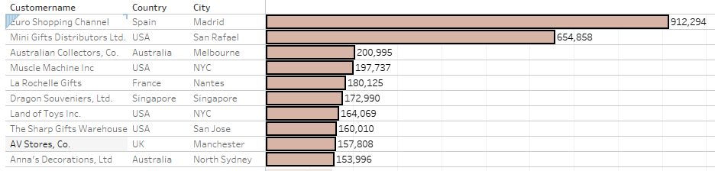
TOP 10 CUSTOMERS BY SALES
Below we see that the top 10 customers with highest sales are based across multiple countries with USA having maximum with 4 followed by Australia with 2.
Spain, France, Singapore, UK each comprise of 1.
Euro Shopping Channel from Spain is the top customer by overall sales.

Slide 18
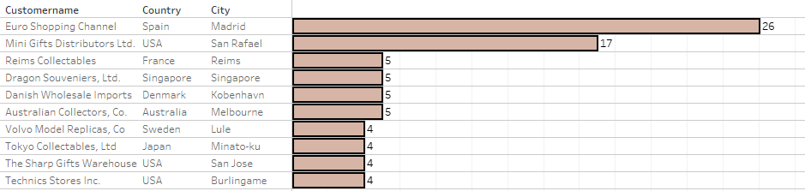
TOP 10 CUSTOMERS BY ORDERS
Top 10 customers by orders are also across multiple countries with USA having maximum with 3. Rest of the other countries have only client with high orders.
The top 2 customers, Euro Shopping Channel with 26 and Mini Gifts Distribution Ltd with 17 are the only clients with double digit orders.
Euro Shopping Channel from Spain is again the top customer by overall orders placed.

Slide 19
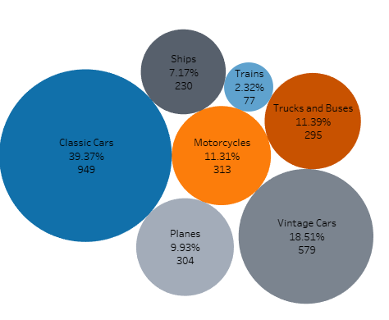
TOTAL SALES & ORDERS BY PRODUCTLINE
Classic Cars has the lions share of overall sales with 39.37 % followed by Vintage Cars at 18.51 % and Trucks and Buses at 11.39 %
Least sales are seen in Trains at 2.32% followed by Ships at 7.17%
So far 949 units have been sold for Classic Cars followed by 579 for Vintage Cars and 313 for Motorcycles
Train are the least ordered at 77 followed by ships at 230 units

Slide 20
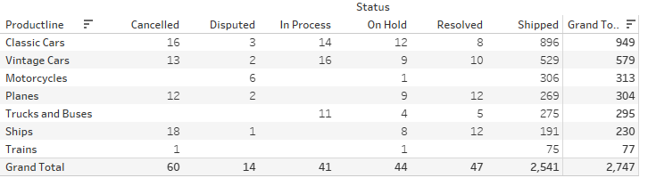
CURRENT STATUS OF PRODUCTLINE
Below is the current status as per each of the seven product lines.
2541 products are shipped, 47 are ready to be shipped, 41 are in process to be delivered.
However, 44 are on hold, 14 are under dispute and 60 have been cancelled.

Slide 21
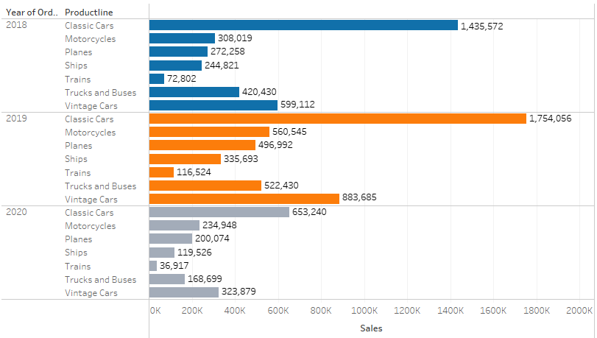
YEARLY SALES BY PRODUCTLINE
Sales across all products have grown YOY from 2018 to 2019.
Sales for Trucks and Buses have been lesser in 2020 so far compared to Motorcycles and Planes.

Slide 22
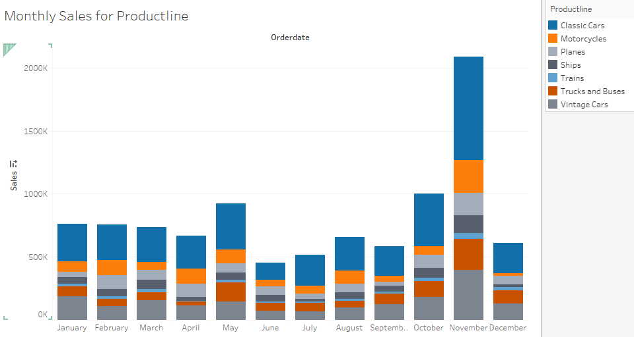
MONTHWISE SALES FOR PRODUCTINE
November accounts for highest sales followed by October and May

Slide 23
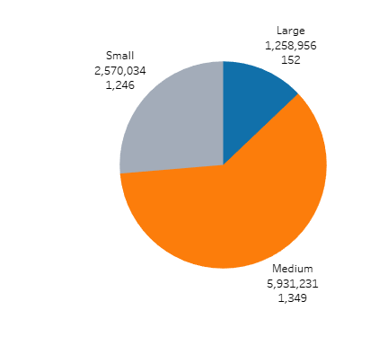
DEALSIZE BY SALES AND TOTAL CUSTOMERS
Medium deal size generates the highest revenue followed by Small.
Large deal sizes are very few in no of orders and revenue both
Medium (1349) and Small (1246) have very similar no of orders. However, the difference in revenue is more than double for medium comparatively.

Slide 24
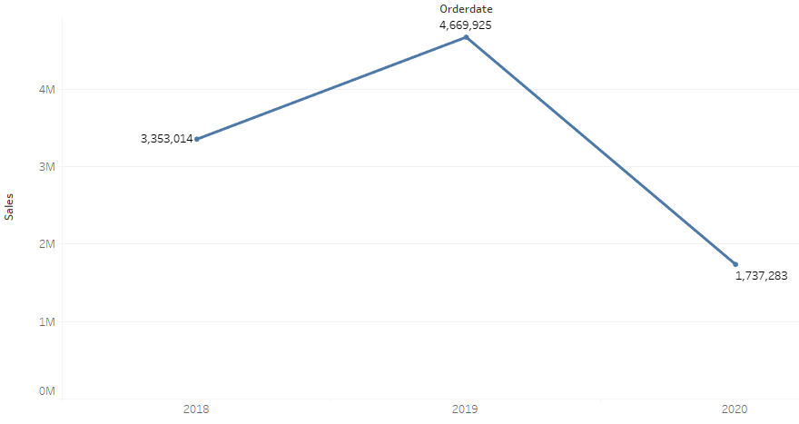
YEARLY SALES TREND
The positive trend from 2018 to 2019 has shifted to negative from 2019 to 2020.

Slide 25
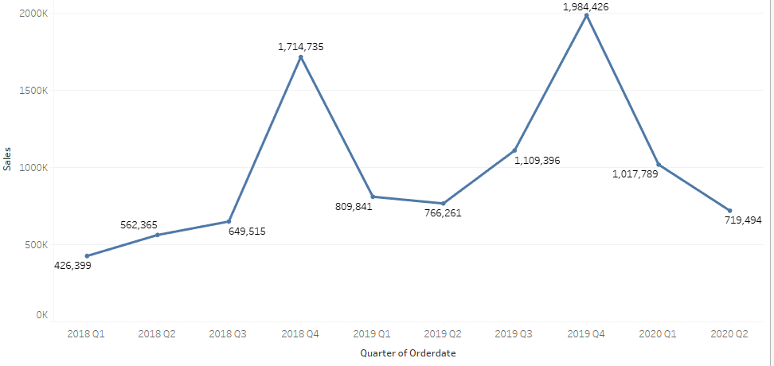
QUARTERLY SALES TREND
The last quarter got the most revenue in 2018 and 2019.
Q1 to Q2, there is a drop is sales in 2020.

Slide 26
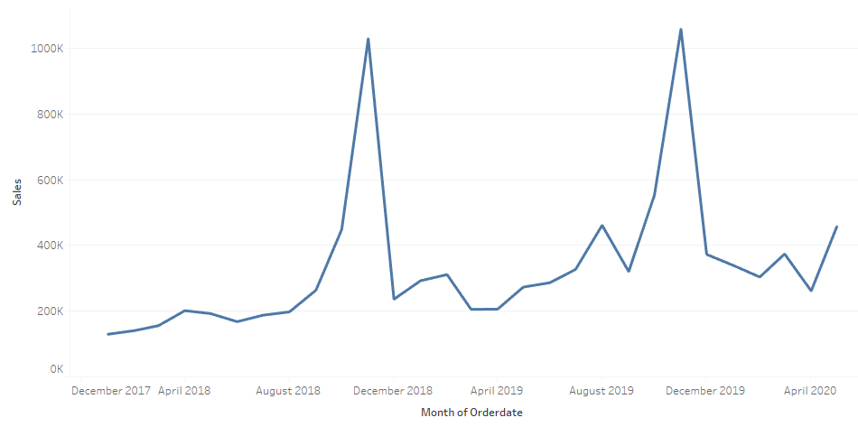
MONTHLY SALES TREND
Sales peak drastically during from September to November every year from 2018 o 2019 and drops drastically thereafter

Slide 27
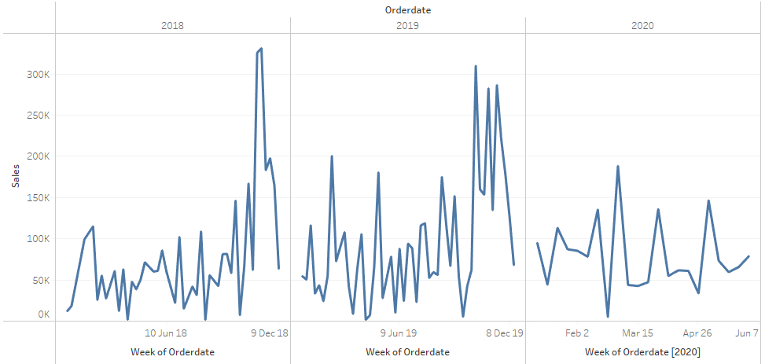
WEEKLY SALES TREND
Weekly trend is similar across all years mostly. Only changes can be seen during the October to December

Slide 28
INFERENCES:
Average of quantity ordered is 35 with min 6 and max 97.
Average for price each is 101 with min 26 and max 252
Average for Sales is 3553 with min 482 and max 14082.
Only the top 2 customers account for double digit orders.
Majority of the deals are medium sized.
Medium (1349) and Small (1246) have very similar no of orders. However, the difference in revenue is more than double for medium comparatively.
Classic Cars has the lions share of overall sales with 39.37 % followed by Vintage Cars at 18.51 % and Trucks and Buses at 11.39 %
Out of 2747, 2541 products are shipped, 47 are ready to be shipped, 41 are in process to be delivered. However, 44 are on hold, 14 are under dispute and 60 have been cancelled.
Top 10 customers by orders are also across multiple countries with USA having maximum with 3. Rest of the other countries have only client with high orders.

Slide 29
INFERENCES:
USA accounts for highest sales followed by Spain in 2nd and France in the 3rd position. The Sales gap between USA and Spain is drastic with sales from USA nearly touching 3 times that of Spain. Hence, efforts can be made to increase sales in Spain and France and the other top 10 countries.
Ireland has the least sales followed by Philippines and Belgium. We can try to cut operational costs in these countries and use it to try and increase customer base.
5 out of the top 10 cities belong to USA which contribute to maximum sales. So, there is a need to try and increase sales and market share in other regions as well.
Trains have the least impact on revenue. So, can think of discontinuing these products or offer them at lower discounted prises
Sales from September to November are at the peak. Hence, need to focus more on marketing and advertising for products month or quarter before to generate interest for new customer acquisitions.
Promotional offers can be run during the periods of fall in sales, for eg; February, June and December especially.

Slide 30
RFM ANALYSIS

Slide 31
What is RFM?
RFM analysis is customer segmentation technique used to measure a worthiness of customer based on three measures as below.
1. Recency (How recently has the customer made a purchase)
2. Frequency (How frequently does the customer purchase)
3. Monetary (What is the revenue that we generate from the customer)

Slide 32
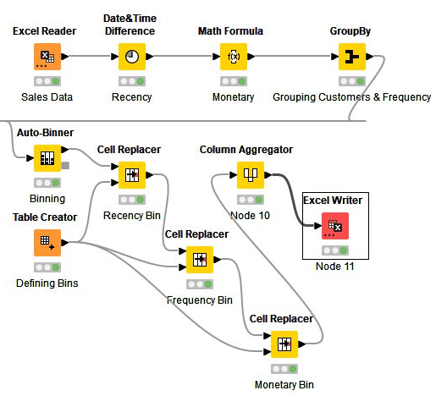
KNIME RFM Analysis
Data is Grouped by CUSTOMERNAME
Customers are divided into 4 segments
We have made the following assumptions:
A) PRICEEACH x QUANTITYORDERED for Monetary
B) Unique Count of ORDERNUMBER for Frequency
C) 31/05/2020 – ORDERDATE for Recency

Slide 33
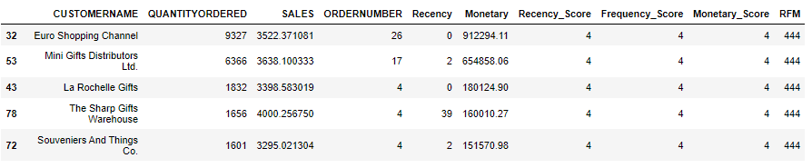
Top 5 Best Customer
These are customers having an RFM Score of 444 which is the best/highest.

Slide 34
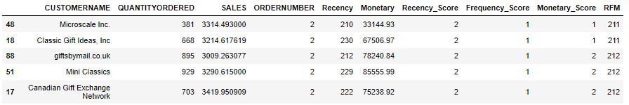
Top 5 Customers on verge of churning

Slide 35
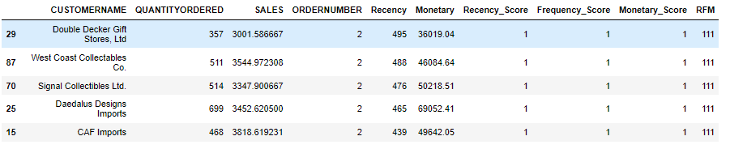
Top 5 Lost Customer
These are customers having an RFM Score of 111 which is the least.

Slide 36
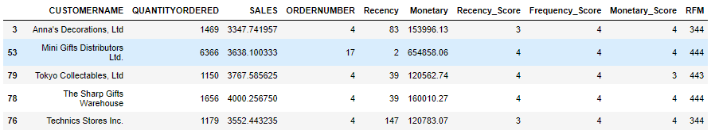
Top 5 Loyal Customers

Slide 37
THANK YOU

